Slide 1
Addressing Modes,
Data Transfer and Manipulation
(Lectures 25-28)

Slide 2
Addressing Mode
Addressing Modes
The operation field of an instruction specifies the operation to be performed.
This operation must be executed on some data stored in computer registers or memory words.
The way the operands are chosen during program execution is dependent on the addressing mode of the instruction.
The addressing mode specifies a rule for interpreting or modifying the address field of the instruction before the operand is actually referenced.

Slide 3

Addressing Mode
Computers use addressing mode techniques for the purpose of accommodating one or both of the following provisions:
To give programming versatility to the user by providing such facilities as pointers to memory, counters for loop control, indexing of data, and program relocation.
To reduce the number of bits in the addressing field of the instruction
Fig: Instruction format with mode field
The availability of the addressing modes gives the experienced assembly language programmer flexibility for writing programs that are more efficient with respect to the number of instructions and execution time.

Slide 4
Addressing Mode
Implied Mode
Although most addressing modes modify the address field of the instruction, there are two modes that need no address field at all. These are the (i) implied and (ii) immediate modes.
The operands are specified implicitly in the definition of the instruction in Implied Mode.
Eg: CMA - Complement Accumulator.
All register reference instructions that use an accumulator are implied-mode instructions.
Zero-address instructions in a stack-organized computer are implied-mode instructions since the operands are implied to be on top of the stack.
Example: CLC (used to reset Carry flag to 0).

Slide 5
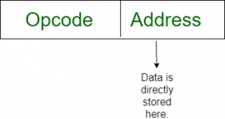
Addressing Mode
Immediate Mode
The operand is specified in the instruction itself.
It has an operand field rather than an address field.
The operand field contains the actual operand to be used in conjunction with the operation specified in the instruction.
They are useful for initializing registers to a constant value.
Eg: ADD 7

Slide 6
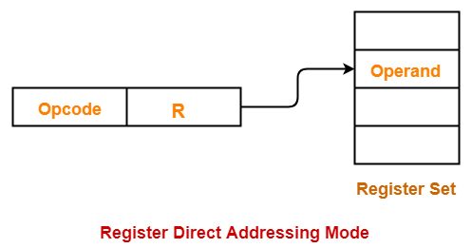
Addressing Mode
Register Mode
The address field specifies a processor register (AC).
In this mode the operands are in registers that reside within the CPU.
The particular register is selected from a register field in the instruction.
A k-bit field can specify any one of 2k registers.
Eg: ADD R1

Slide 7
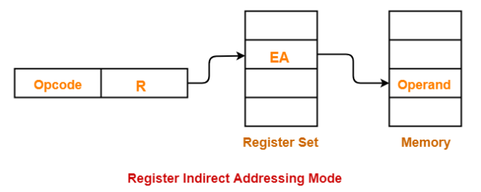
Addressing Mode
Register Indirect Mode
The instruction specifies a register in the CPU whose contents give the address of the operand in memory.
The selected register contains the address of the operand rather than the operand itself.
Before using a register indirect mode instruction, the programmer must ensure that the memory address of the operand is placed in the processor register with a previous instruction.
Advantage - The address field of the instruction uses fewer bits to select a register.

Slide 8
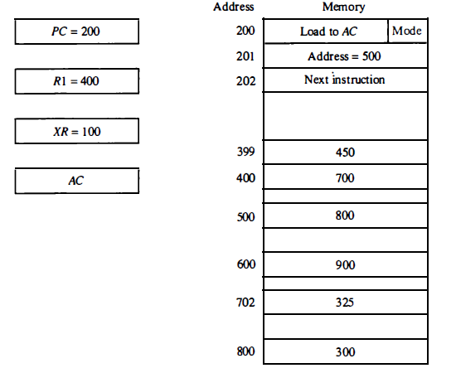
Addressing Mode
Auto-increment and Auto-decrement
Auto-Increment:- This is similar to Register indirect mode except that the register is incremented by 1 after its value is used to access memory.
In case of auto-increment, the effective address is 400 with operand 700. After this it would be incremented to 401.
Auto-Increment:- This is similar to Register indirect mode except that the register is decremented by 1 before its value is used to access memory.
In case of auto-decrement, the effective address is 399 and operand is 450.

Slide 9
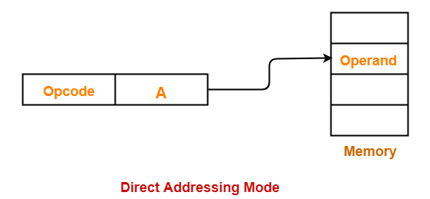
Addressing Mode
Direct and Indirect Address Mode
Direct Address Mode: In this mode the effective address is equal to the address part of the instruction. The operand resides in memory and its address is given directly by the address field of the instruction. In a branch-type instruction the address field specifies the actual branch address.

Slide 10
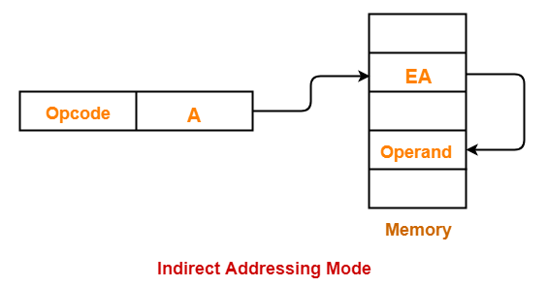
Addressing Mode
Direct and Indirect Address Mode
Indirect Address Mode: In this mode the address field of the instruction gives the address where the effective address is stored in memory. Control fetches the instruction from memory and uses its address part to access memory again to read the effective address.

Slide 11
Addressing Mode
Direct and Indirect Address Mode
In case of direct addressing, the effective address is 500 with operand 800.
In case of indirect addressing, the effective address is 800 and operand is 300.

Slide 12
Addressing Mode
Relative Mode
Content of the program counter is added
to the address part of the instruction in
order to obtain the effective address.
This number is added to the content of the program counter, producing an effective address whose position in memory is relative to the address of the next instruction.
Example:
PC contains the number 201. The address
part of the instruction contains the number
500.
The instruction at location 201 is read from
memory during the fetch phase and the
program counter is then incremented by one
to 202.
The effective address computation for the
relative address mode is 202+ 500= 702
and operand is 325.

Slide 13
Addressing Mode
Indexed Addressing Mode
In this mode the content of an index register is added to the address part of the instruction to obtain the effective address.
The index register is a special CPU register that contains an index value.
The address field of the instruction defines the beginning address of a data array in memory.
The distance between the beginning address and the address of the operand is the index value stored in the index register.

Slide 14
Addressing Mode
Base Register Addressing Mode
In this mode the content of a base register is added to the address part of the instruction to obtain the effective address.
This is similar to the indexed addressing mode except that the register is now called a base register instead of an index register.
The difference between the two modes is in the way they are used rather than in the way that they are computed.
An index register is assumed to hold an index number that is relative to the address part of the instruction.
A base register is assumed to hold a base address and the address field of the instruction gives a displacement relative to this base address.

Slide 15
Addressing Mode
Numerical on Addressing Mode
An instruction is stored at location 200 with its address field at location 201. The address filed has the value 500. A processor register R1 contain the number 400 and index register value is 100. Evaluate the effective address if the addressing mode of the instruction is given below in the statement.

Slide 16
Addressing Mode
Numerical on Addressing Mode
An instruction is stored at location 200 with its address field at location 201. The address filed has the value 500. A processor register R1 contain the number 400 and index register value is 100. Evaluate the effective address if the addressing mode of the instruction is given below in the statement.
Addressing mode | Effective address | Content of AC
Direct Address Mode | 500 | 800
Immediate Mode | 201 | 500
Indirect Mode | 800 | 300
Relative Mode | PC + address field of the instruction 202+500=702 | 325
Index Register Mode | Index Register Value + address field of the instruction 100+500=600 | 900
Register Direct | _________ | 400
Register Indirect Mode | 400 | 700
Auto Increment Mode | 400 | 700
Auto Decrement Mode | 399 | 450

Slide 17
Data Transfer and Manipulation

Slide 18
Data Transfer and Manipulation
DATA TRANSFER AND MANIPULATION
Instruction set of different computers differ from each other mostly in way the operands are determined from the address and mode fields.
The basic set of operations available in a typical computer are:
Data Transfer Instructions: Move data from one place in computer to another without changing the data content. Most common transfer: processor register-memory, processor register-I/O, between processor register themselves.
Data Manipulation Instruction: Perform arithmetic, logic and shift operation.
Program Control Instructions: Decision making capabilities, change the path taken by the program when executed in computer.

Slide 19
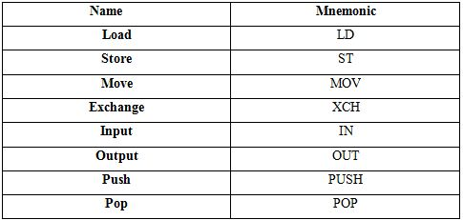
Data Transfer and Manipulation
1. Data Transfer Instructions: Move data from one place in computer to another without changing the data content Most common transfer: processor register-memory, processor register-I/O, between processor register themselves.

Slide 20
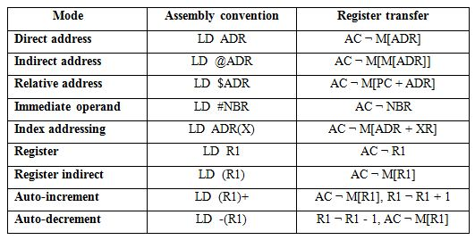
Data Transfer and Manipulation
Some assembly language conventions modify the mnemonic symbol to differentiate between the different addressing modes.

Slide 21
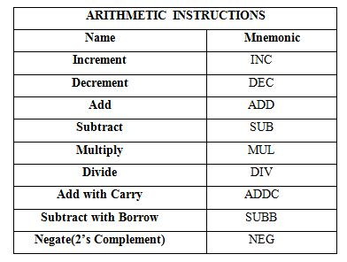
Data Transfer and Manipulation
2. Data Manipulation
These instruction performs operation on data and provide the computational capabilities for the computer.
Three Basic Types: 1. Arithmetic instructions 2. Logical and bit manipulation instructions 3. Shift instructions
2.1 Arithmetic instructions:- Four basic arithmetic operations: + - * /

Slide 22
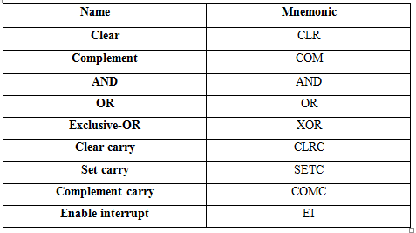
Data Transfer and Manipulation
2.2 Logical and bit manipulation instructions: Logical Instructions perform binary operations on string of bits stored in registers.
→Useful for manipulating individual/ group of bits.
→ Consider each bit separately.
AND →Clear selected bits
OR →Set selected bits
XOR →Complement selected bits

Slide 23
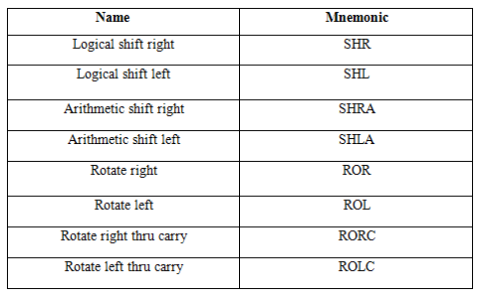
Data Transfer and Manipulation
2.3 Shift Instructions: Shift instructions allow the bits of a register or memory byte to be shifted one bit place to the left or to the right. There are two types of shift instructions — logical and arithmetic. Logical shifts consider the contents of the register or memory byte to be just a bit pattern when the shift is made.

Slide 24
Thank You

